Slide 1
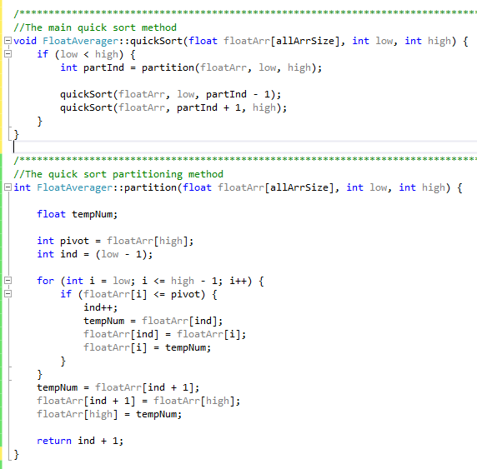
- The quicksort method first checks whether the highest index in the data set is still greater than the lowest index. As the quicksort continues to recur, the lowest and the highest index of a dataset will increase and decrease respectively until one is no longer greater or less than the other, hence, ending the recursion loop.
- Creates a partition point using the partition method.
Sets the pivot point as the value occupying the highest index in the data set. (The pivot is the value in the dataset that will be compared against all other values in the data set in order to create two new data sets, one with all larger numbers, and another one with all smaller numbers than the pivot value.)
Initiate the “ind” variable that will keep track of the index that contains the highest number that is less than the pivot value.
- The for-loop traverses the data set. Whenever it accesses an index that contains a value that is less than or equal to the pivot value, it will swap the value for a previously traversed value that is greater than the pivot value.
- Establishes the pivot value as the partition that divides the data set into two new data sets. This function returns the index of the partition value.
- Uses the partition index to establish the high and the low index value for when the quicksort function recur.

